Slide 1
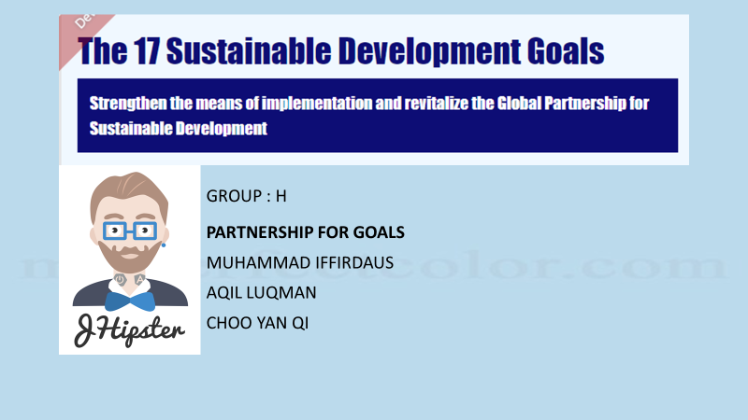

Slide 2

INTRODUCTION
The SDGs are aimed at achieving a better and more sustainable future for all. SDG 17, in particular, focuses on strengthening partnerships for sustainable development. The goal emphasizes the importance of collaboration, knowledge sharing, and capacity building across countries and stakeholders
The purpose of this project is to develop software that integrates and displays data from all SDGs and creates a donation gateway to support maintenance of the software and database

Slide 3
SDGs 17 GOALS
What is SDGs 17 ?
Partnership for the goal. In definition, to support for the targeted capacity for developing countries.
What is SDGs 17 purpose ?
Contribute through various projects to achieving the goals by work and volunteer in any NGOs that working towards Global Goals
How is SDGs 17 works?
For this projects, other SDGs user can create the program and the customer can support the program with the donation.

Slide 4
OBJECTIVES
1.Integrate and display data from all SDGs: The software will integrate data from all SDGs to provide a comprehensive view of sustainable development initiatives.
2.Create a donation gateway: The software will create a donation gateway to support the entire programme created and the maintenance of the software.

Slide 5
SCOPE PROJECT
1.Design and development of the software using Java programming language
2.Integration of data from all SDGs
3.Creation of a donation gateway
4.Use of MySQL database for data storage
5.Testing and refinement of the software
6.Security and data privacy

Slide 6
How does it work?
Customer
Update- News
Support- SDGs Activities
Direct Donate
Voting (1-10) their support on the programme
Data Collected for Collab/sponsorship

Slide 7
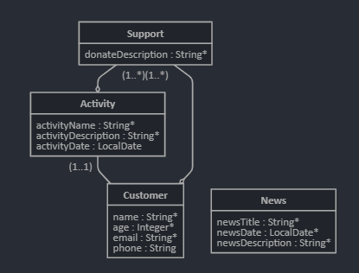
Entity diagram SDGs 17 GOALS
OneToMany
One Activity can have Many support
OneToMany
One Customer can have Many support
OneToOne
One customer have One activity

Slide 8
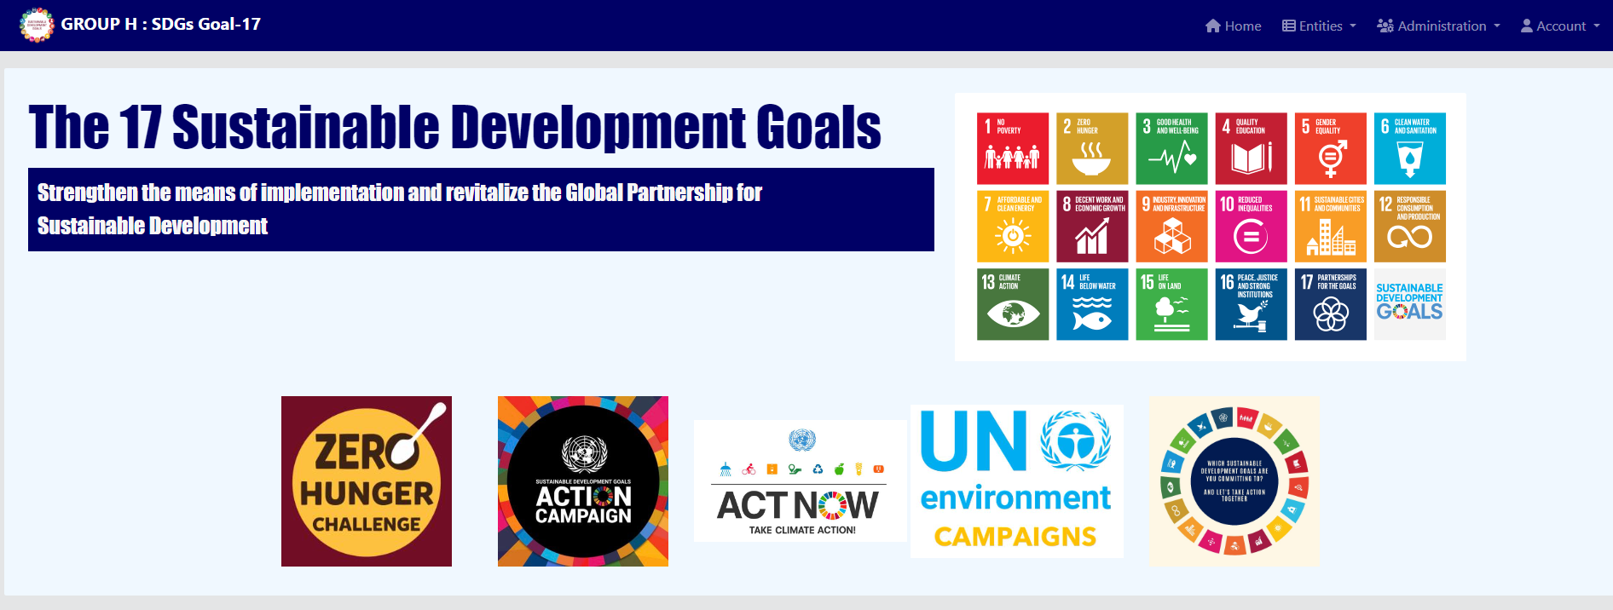

Slide 9
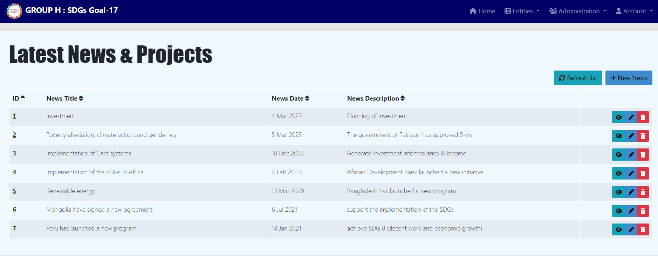

Slide 10
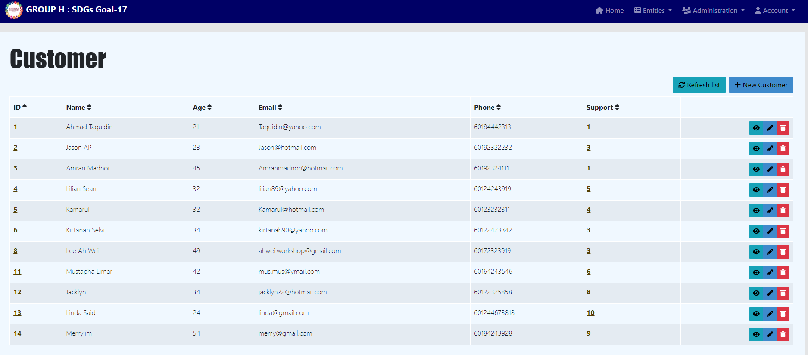

Slide 11
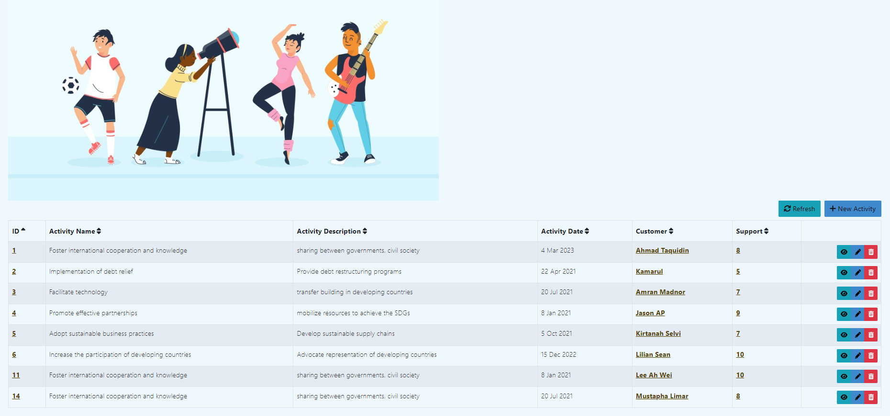

Slide 12
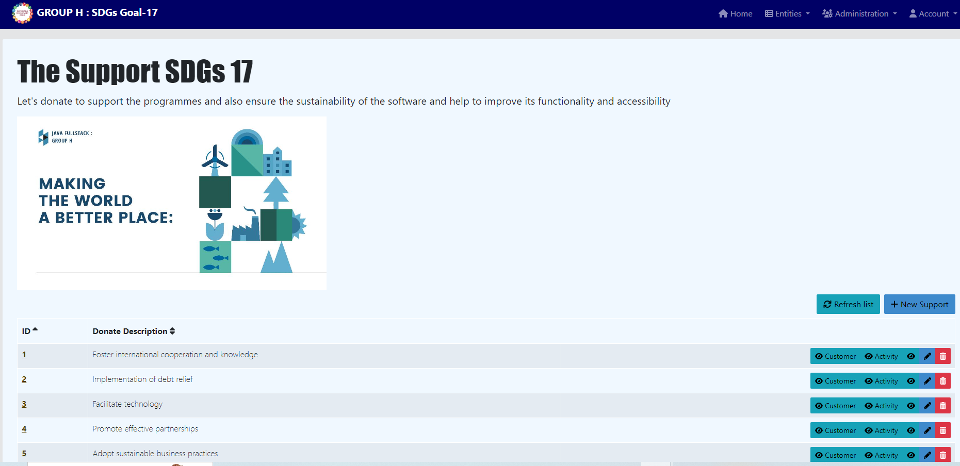

Slide 13
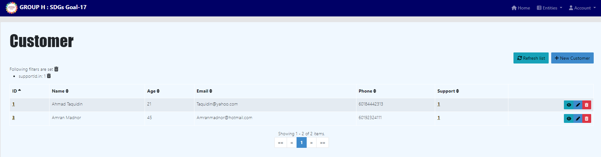
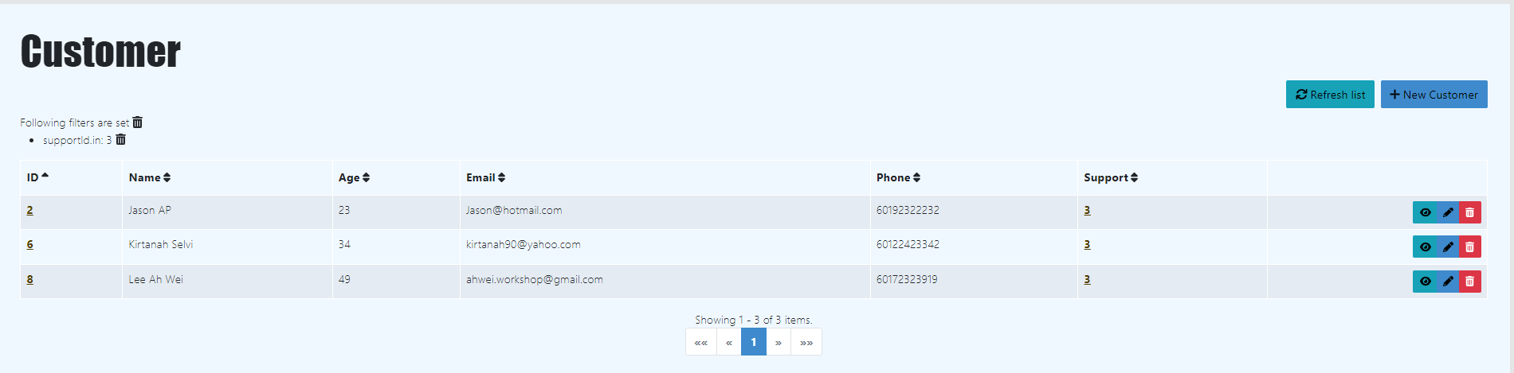

Slide 14
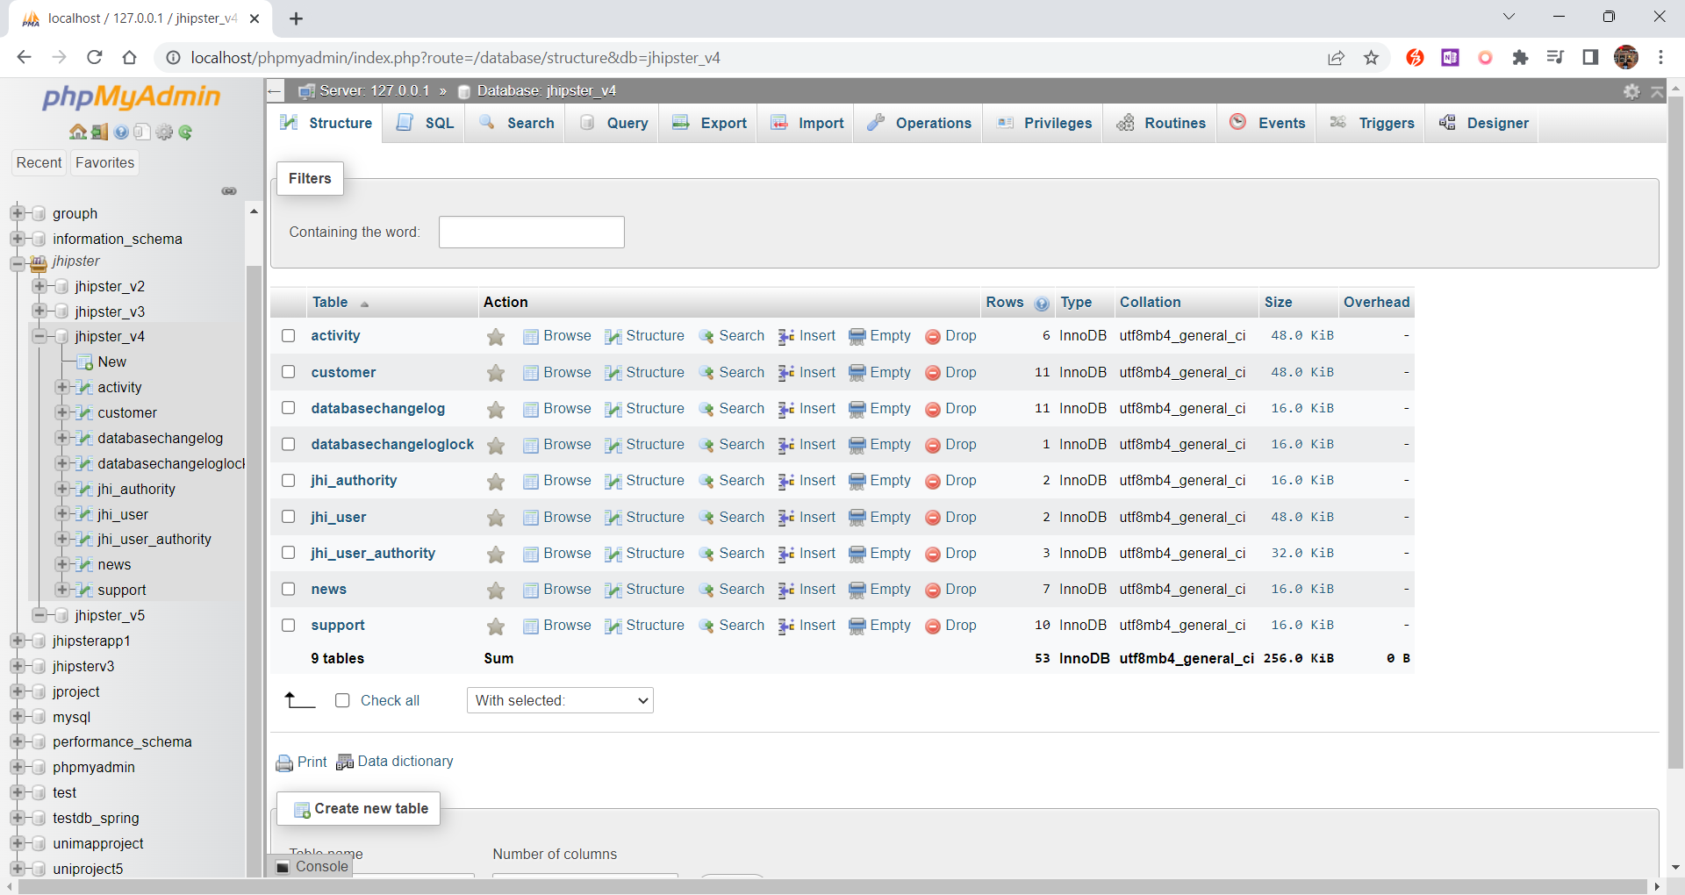

Slide 15
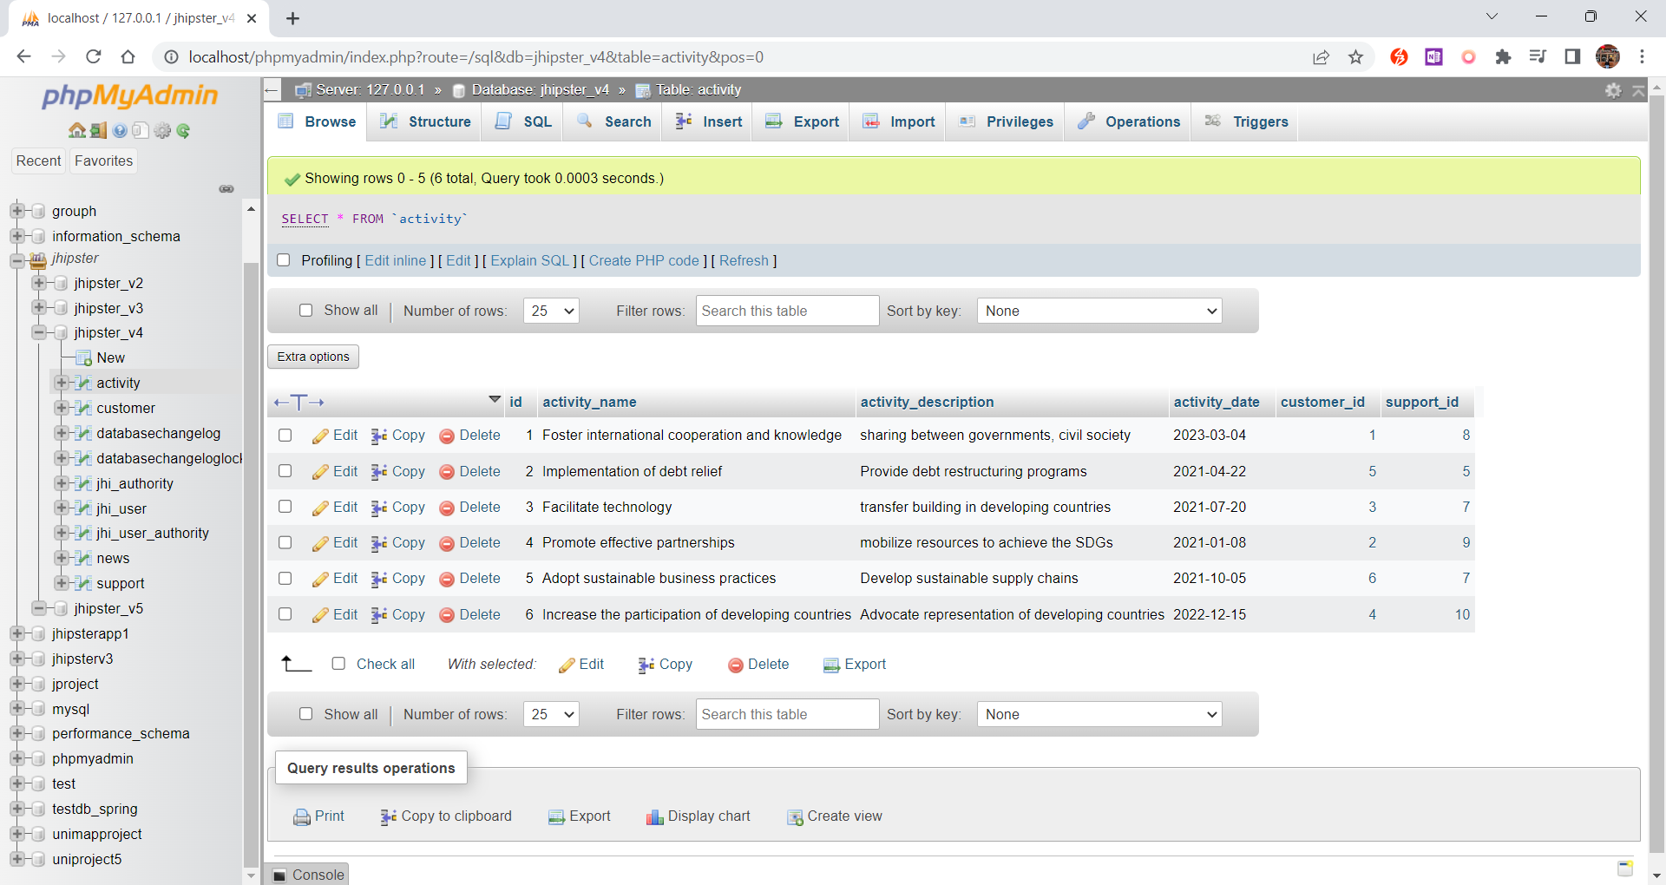

Slide 16
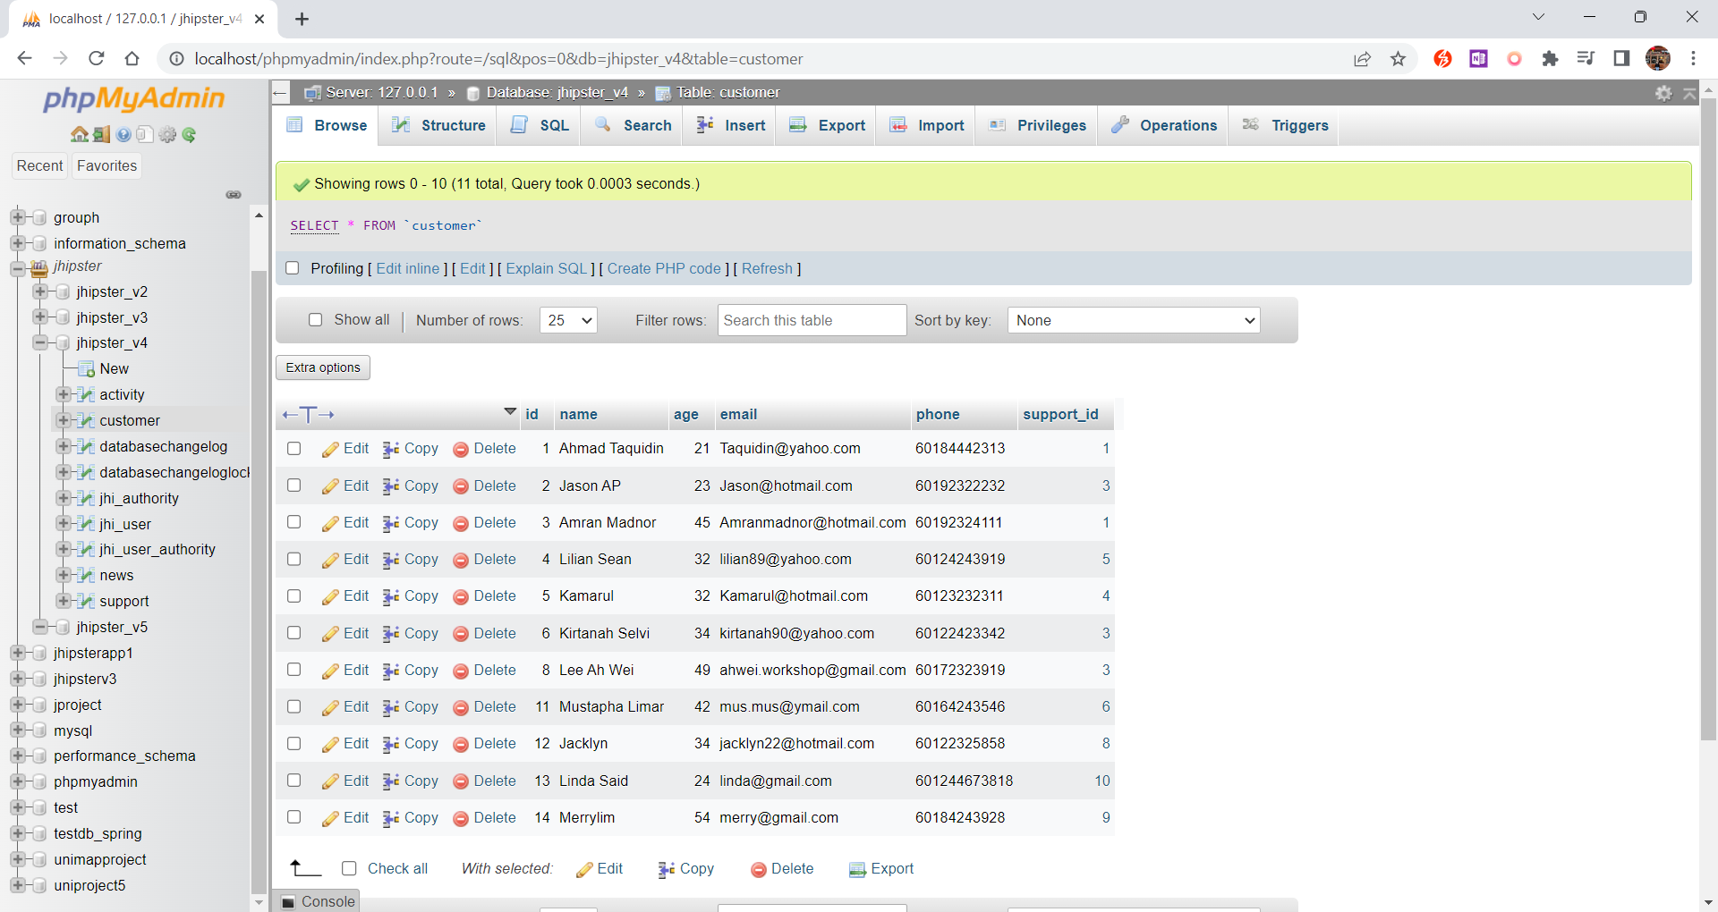

Slide 17
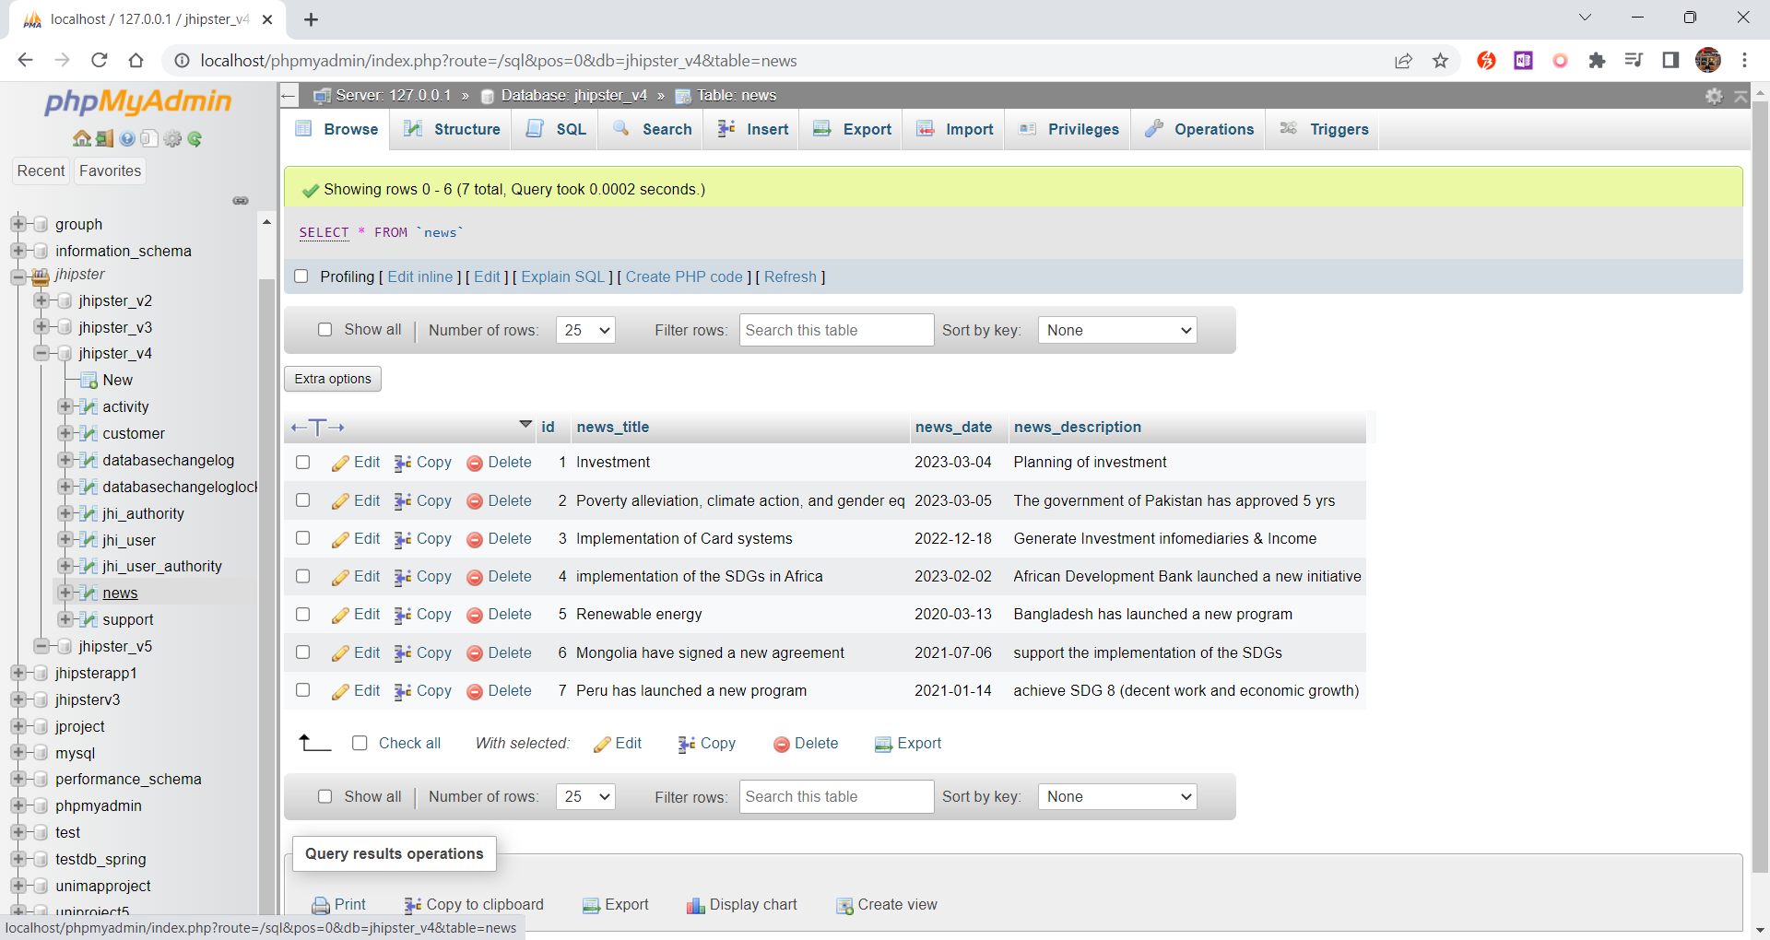

Slide 18
